Slide 1
Solutions of First-Order Differential Equations
zero-state
response
zero-state
response
If a<0 then z.s. response and probably some part of the z.s. response goes to zero as time goes to infinity. This part of the solution is called transient solution (geçici çözüm). The remaining part in z.s. solution (which does not go to zero) is called the steady state solution (kalıcı çözüm).
steady
solution
transient solution

Slide 2
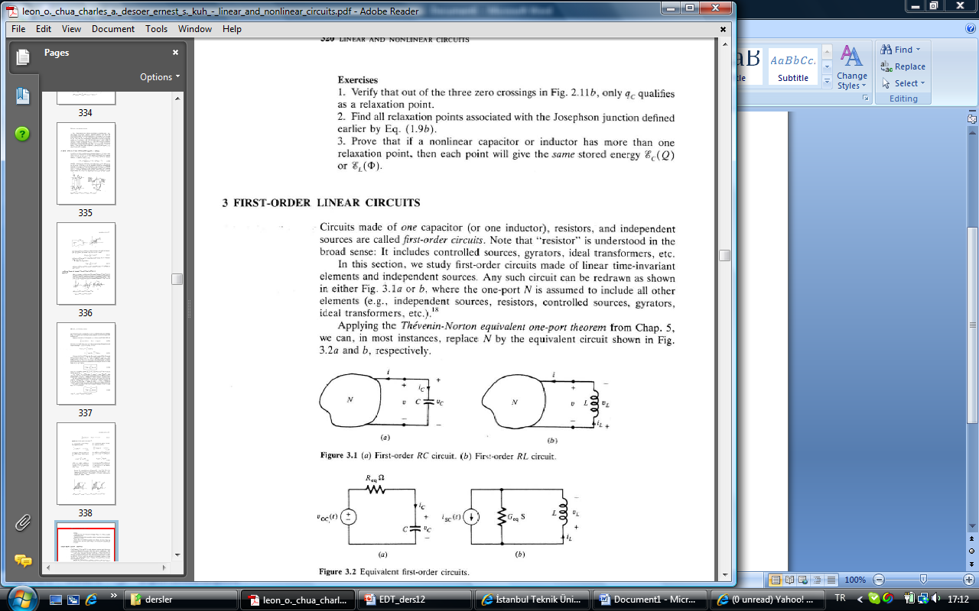
First-Order Linear Circuits
transient solution
steady
solution
L.O. Chua, C.A. Desoer, S.E. Kuh. “Linear and Nonlinear Circuits” Mc.Graw Hill, 1987, New York

Slide 3
Higher Order Circuits – How To Obtain State Equations?
Consider a circuit with capacitor, inductors, n-terminal resistors and independent sources.
Aim is to obtain to obtain state equations in the following form:
state variables
- some capacitor voltages and some inductor currents (mostly all)
output variables
- currents and voltages under consideration
input variables
- values for independent sources
Method:
Step 1: Draw the circuit graph and choose an appropriate tree:
a-) Choose voltage sources as twigs, if tree is not completed continue with (b).
b-) Choose capacitors as twigs (you may have to exclude some capacitors), if tree is not completed continue with (c).
c-) Choose current-controlled edges of resistors as twigs, if tree is not completed continue with (d).

Slide 4
d-) choose inductors as twigs.
Step 2: Determine the state variables:
capacitor voltages in twigs and inductor currents in chords.
Write element equations for state variables:
Step 3: Calculate state equations:
Write linearly independent current equations:
KVL’s for fundamental cut-sets
Write linearly independent voltage equations:
KCL’s for fundamental loops
Using these equations obtain currents of capacitors in twigs and voltages of inductors in chords in terms of state variables and inputs.
Which elements are these?

Slide 5
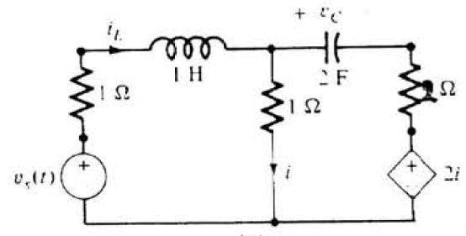
An Example
Write state equations for the following circuit.
L.O. Chua, C.A. Desoer, S.E. Kuh. “Linear and Nonlinear Circuits” Mc.Graw Hill, 1987, New York

Slide 6
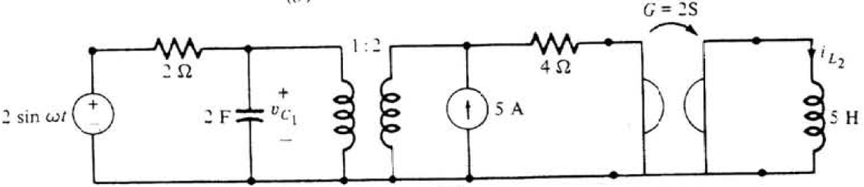
An Example
Write state equations for the following circuit.
L.O. Chua, C.A. Desoer, S.E. Kuh. “Linear and Nonlinear Circuits” Mc.Graw Hill, 1987, New York

